Slide 1
The Who, What, When and Where of Medicare Advantage Utilization?
Sarah Manning, Nick Carson, Younes Kassemi, Jeff Sochor

Slide 2

What is Medicare Advantage?
Medicare is a federal government program that offers health care coverage to individuals that are over 65, under 65 and have certain disabilities, or under under 65 and have End Stage Renal Disease.
Typically is referring to Part A and Part B
Medicare Advantage is a type of Medicare plan offered by Private Health Insurance Companies, also known as Part C
Benefits:
Prescription Drug Plan
Coordinated Care
Only offered in specific Service Areas
Notes:
Sarah

Slide 3
Data Sources Collected
Centers of Medicare & Medicaid Services
Monthly Enrollment by Contract/Plan/State/County
July Data for 2014-2018
US Census
Population Estimates by Characteristics
Income Data
Latitude and Longitude by County
Notes:
Sarah

Slide 4
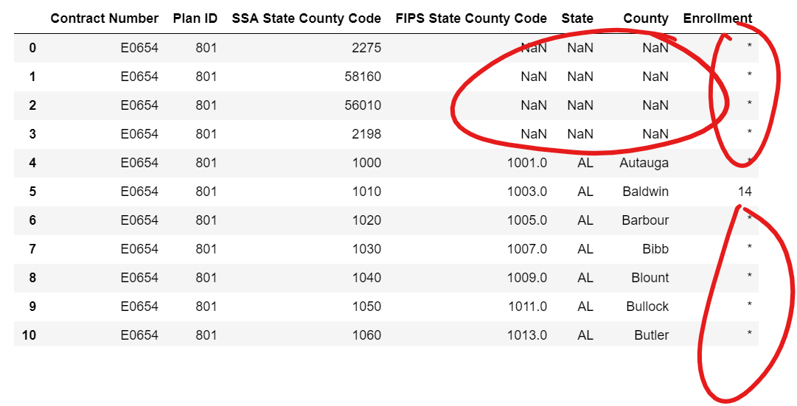
Data Cleaning: Before

Slide 5
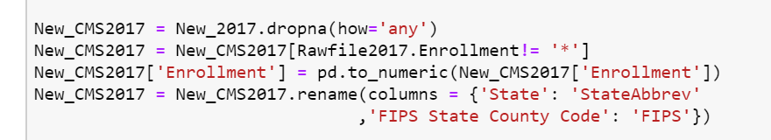
Data Cleaning: Code

Slide 6
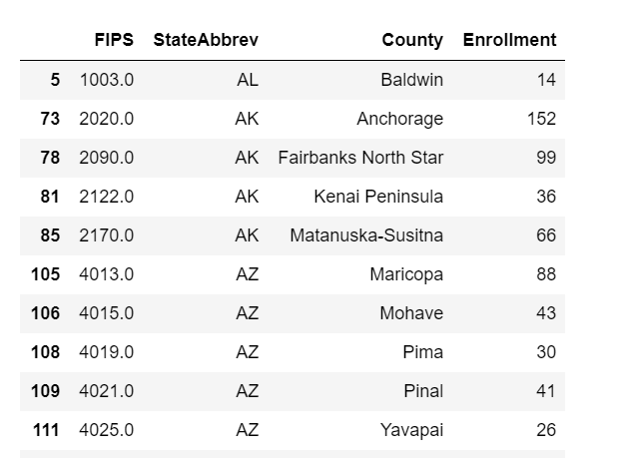
Data Cleaning: After

Slide 7
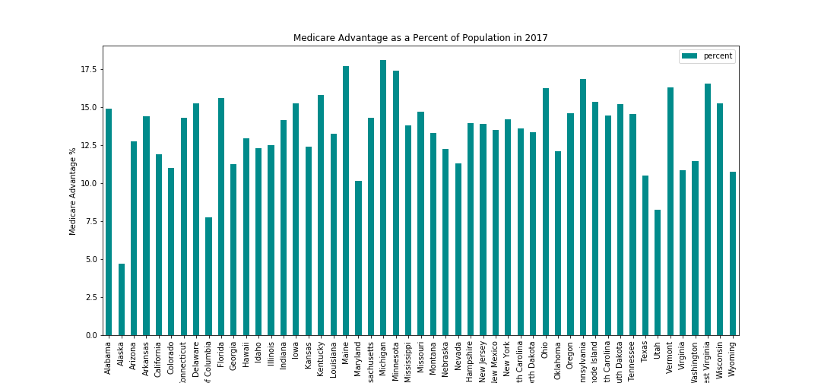
Where do Medicare Advantage members live?
Notes:
Nick
Where do Medicare Advantage members live? -
We wanted to look at what percent of a states population is using medicare.
To do this we looked at 2017 Census data and Medicare enrollment for the same year.
On average the percent of a states population on medicare is 13.48% with a stddev of 2.57%. There are a few outlier states here, the most significant being Alaska. (explain that Alaska has limited plan options)

Slide 8
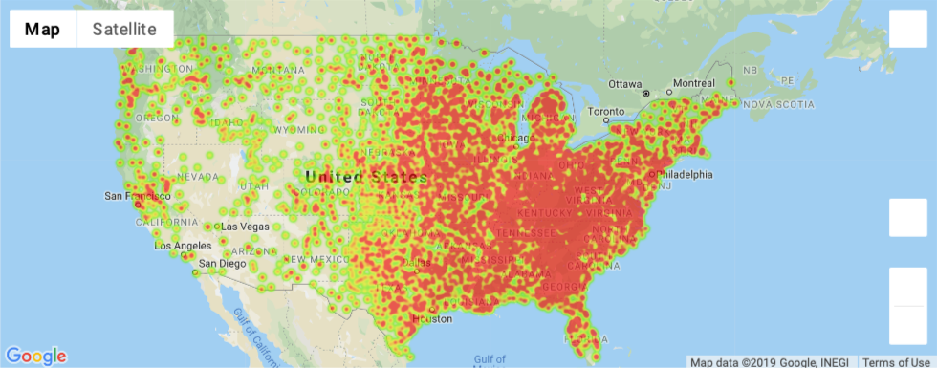
Where do Medicare Advantage members live?
Notes:
Nick
Here we created a heatmap that shows the density of an areas Medicare usage in 2017.
Instead of using state wide stats, we wanted a more granular view, so we looked at things on a county by county level. ( 3129 counties)
Every county in the county has a unique identifier called a FIPS ( Federal Information Processing Standard) code. We used converted each FIPS into a Lat&Long coord to be able to make the graph.
From this we can see that Medicare Advantage usage is concentrated mostly in the Eastern US & Midwest.From our research, we know three main private insurance companies account for most of the membership. The largest being Humana which is based in Louisville, KY and that is obviously represented on the map.

Slide 9
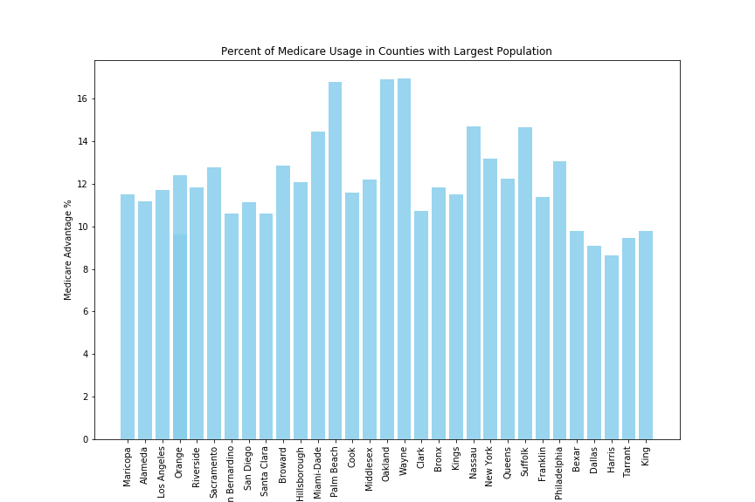
Where do Medicare Advantage members live?
What does the Medicare usage look like in the most populous counties?
Mean = 14.059%
Std Dev = 3.99%
Notes:
Nick
We wanted to look at the largest counties in the country to see if they utilize medicare more or less than the average.
Here we have graphed the top 1% most populous counties and their medicare usage. We will touch more on this a bit later-

Slide 10
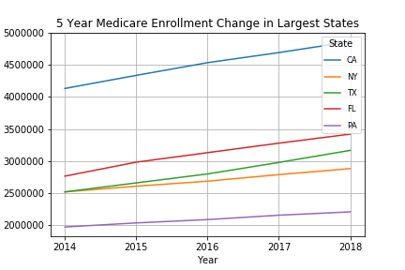
When are members enrolling in Medicare Advantage?
Enrollment in Medicare Advantage has nearly doubled over the past decade
National average: 34%
Notes:
Medicare Modernization Act

Slide 11
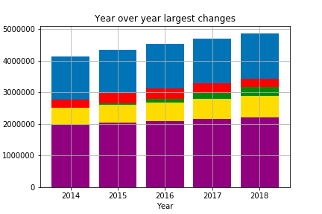
Medicare enrollment: 2014 - 2018
‘14 Average Medicare Advantage
enrollment : 27,531.87
‘18 Average Medicare Advantage
enrollment: 32,753.77
+15.94% increase
National Average: 42% by 2028

Slide 12
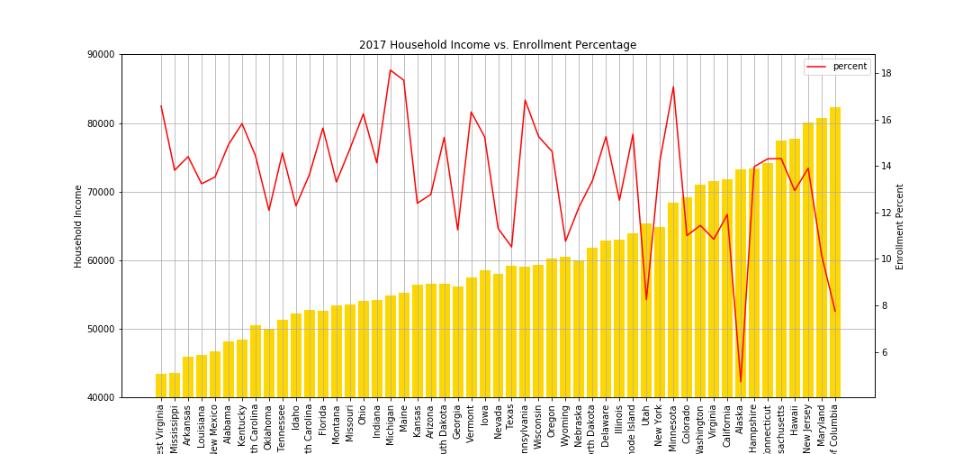
Who is most likely to utilize Medicare Advantage?
States arranged by ascending household income (median $61,372)
Notes:
Jeff
We arranged a bar graph displaying all 50 states (and D.C.) ascending by Household Income, a range of about $43k to $82k. Overlaid is the Enrollment Percentage in red, a range of about 4.5% to 18%.
State Median Household Income - $61,372
State Avg. Enrollment - 13.5%
Answering the question “Who?”, with regards to income, everybody.

Slide 13

Who is most likely to utilize Medicare Advantage?
Is a person living in a less populous county more likely to enroll in Medicare Advantage?

Slide 14
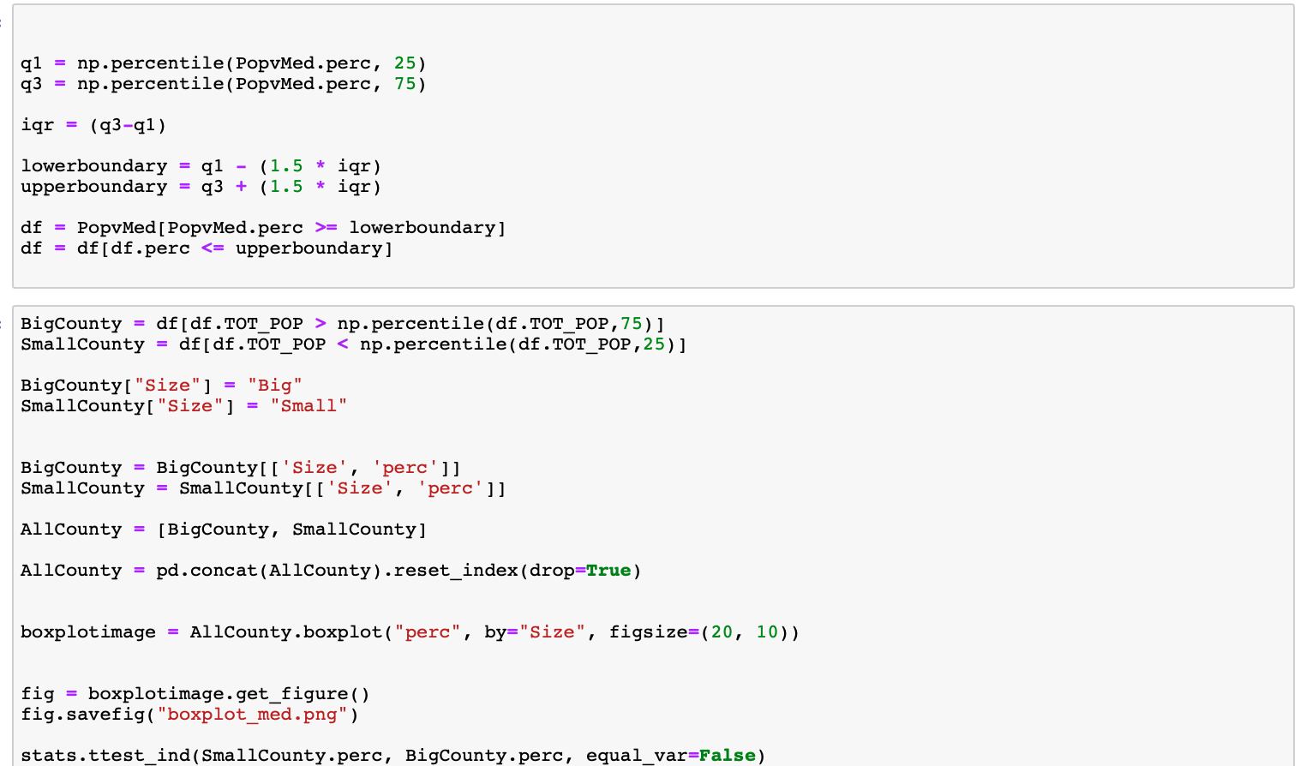
Who is most likely to utilize Medicare Advantage?
Is the population of a county related to the percent of people enrolled in Medicare Advantage?

Slide 15
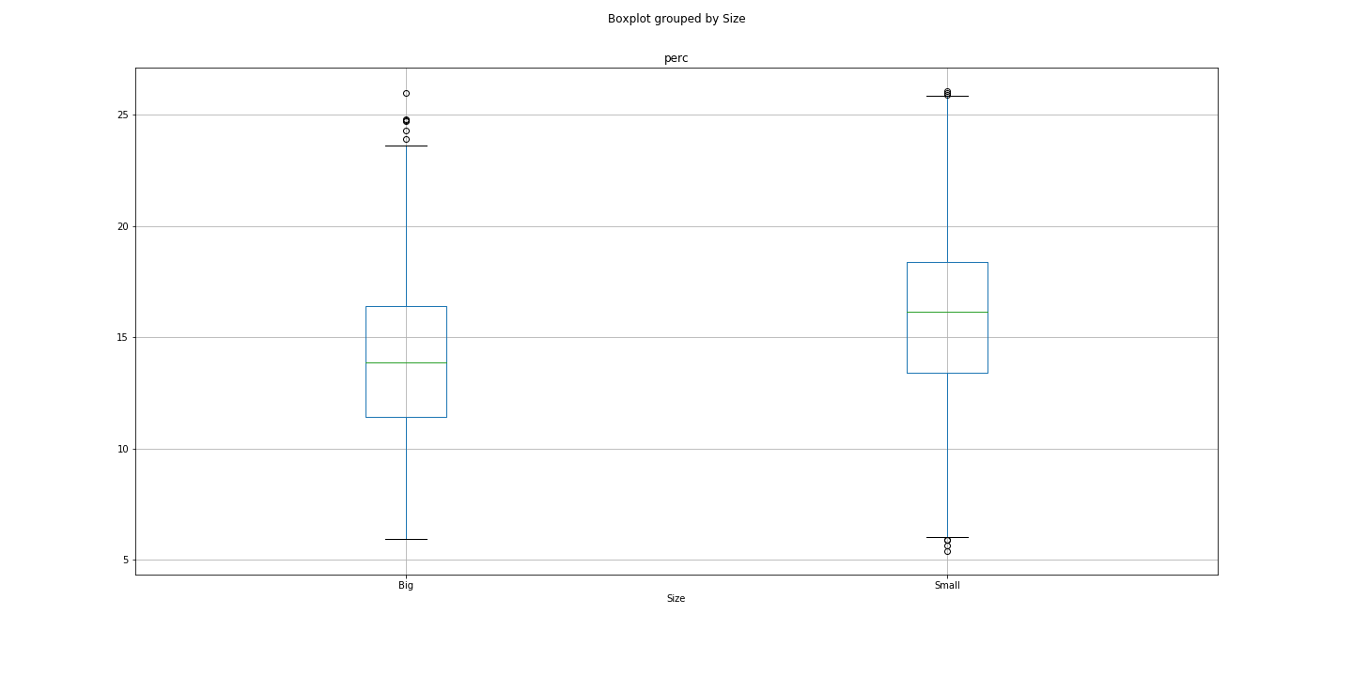
Box Plot and T-Test
Results:
There was a significant difference in the percent Medicare Advantage in the most populous counties when compared to the least populous counties; tstatistic=9.483498664933572, pvalue=9.238829627876864e-21.
Notes:
Sarah

Slide 16




Goodbye!

